Slide 1
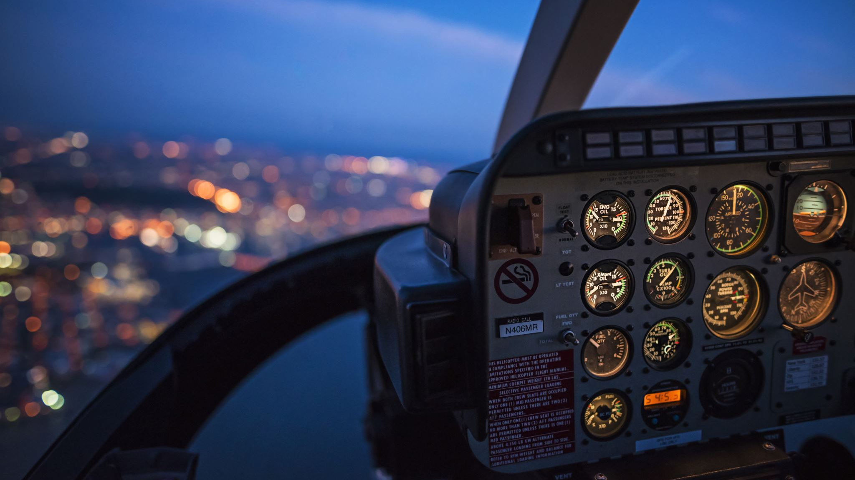
Atmospheric Turbulence Prediction Models for Safer Aircraft Navigation
Presented by: Rindhuja Johnson
Student ID: CL61733
Technical Paper presentation for DATA 603
Instructor: Najam Hassan

Slide 2
Introduction
Clear Air Turbulence (CAT): An atmospheric phenomenon due to convective heating of different layers of air, especially above 15,000 ft, leading to pressure differences.
Thesis
A study on the evolution of the air turbulence prediction models (1977 – present) and look into the best adaptable models.
How to predict such an occurrence?
Scope
Addressing the increasing demand for safety in aviation through ongoing advancements in meteorological research, technological innovation, the integration of field expertise and machine learning, global data collaboration, and the continuous improvement and adaptation of models for safer and more efficient aircraft navigation

Slide 3
Literature Review
D. K. Lilly (1977): Colorado Downslope Windstorm Reports from pilots – adverse weather conditions
T. L. Clark (2000): Extended the study into CAT occurrences with significant improvement in data extraction technologies.
R. Sharman (2006): Introduced Graphical Turbulence Guidance (GTG) – modified by J. C. Kim (2014)
A. Rafalimanana (2022) and Yoshimura (2023): Concentrated on the Weather Research and Forecasting model and Numerical Weather Prediction model respectively improving the data quality and latency
Williams (2013) and K. K. Hon (2022): Introduced ML models along the NWP models and pilot reports

Slide 4
Technical Review
1. Lilly's Comprehensive Analysis (Lilly, 1977)
In-depth exploration of wind speed, direction, pressure differentials, surface pressure, and temperature profiles.
Meticulously collected data spans from days to an impressive eight-year duration within the specified region.
Blend of mathematical and physical analyses makes it an essential resource for future investigations.

Slide 5
Technical Review
2. Clark et al's CAT Simulation (Clark, 2000)
Utilizes the Clark-Hall Model with four levels of grid refinement for CAT simulations.
Large-scale domain: 25.6 km horizontal grid over 820 km by 820 km with mesoscale analyses every three hours over the continental United States.
Innermost domain: 200 m horizontal grid, focusing on turbulence over a 48 km region by 12.7 km vertically.
The simulation incorporates 0900 UTC MAPS analysis data, providing high resolution in the last 30 minutes.

Slide 6
Technical Review
3. GTG System Revolution (R. Sharman, 2006)
The Graphical Turbulence Guidance (GTG) system revolutionizes forecast models.
Integrates large-scale atmospheric features from NCEP's RUC-2 NWP model.
Real-time incorporation of weighted turbulence diagnostics based on pilot reports, updated with each RUC model update.
4. Kim et al's Modified GTG System (Kim J., 2014)
Modification of the GTG system using a time-lagged ensemble of NWP forecasts.
Provides probabilistic information about turbulence likelihood using turbulence diagnostics.
Implements high-resolution NWP model with 3 km horizontal grid spacing covering CONUS.
Utilizes Advanced Research version of Weather Research and Forecasting Model (ARW) on Pleiades supercomputer for precise predictions.

Slide 7
Technical Review
5. Optimal Turbulence Prediction (Rafalimanana A., 2022)
A blend of WRF and OT models achieves predictions of nearly 24 hours.
Simulations run 12 – 18 hours before the predicted time.
Testing of three Planetary Boundary Layer (PBL) schemes and two Land Surface Models (LSM) to find optimal WRF design.
WRF model features a vertical grid with 46 levels, with resolution decreasing slowly with height.
Data was gathered from the Cerro Pachón campaign, with radio-sounding data providing high vertical resolution.
WRF model predictions compared to the data yielded an MRE under 6.4%.

Slide 8
Technical Review
6. Clear Air Turbulence Event Resolved (Yoshimura, 2023)
A clear Air Turbulence event over Tokyo in 2020 addressed using a mesoscale NWP model.
NWP model simulates the event with varying horizontal resolutions.
Initial and boundary conditions are generated based on JMA-MSM analysis data updated every three hours.
2D flight simulation applied based on NWP results and additional meteorological data.
Data collected from three aircraft encountering maximum turbulence validated with flight simulation data.

Slide 9
Technical Review
7. Machine Learning in Turbulence Prediction (Williams, 2013; Hon K. K., 2020; Zhuang Z., 2023)
Williams utilizes ground-based Doppler radar, satellite imagery, lightning detection network, and other features for predictions.
XGBoost model combines data from pilot reports and turbulence indices from the NWP model.
LiDAR turbulence identification model, based on XGBoost and CGAN, reduces false alarms on turbulence predictions.

Slide 10
Obstacles
Limitations of GTG System (R. Sharman, 2006)
Inconsistencies tied to NWP models, model resolutions, and errors at resolvable scales.
Reliance on pilot reports introduces human judgment issues.
The inability to handle large data impacts prediction accuracy.
2. Kim et al’s Enhancement and Challenges (Kim J., 2014)
Improved GTG system lacks 3D optimization for fuel and travel time minimization.
The high latency of forecasts needs addressing for real-time predictions.

Slide 11
Obstacles
3. Optical Turbulence Model on WRF (Rafalimanana A., 2022)
Implementation yields satisfactory turbulence predictions and seasonal analysis.
Calls for improvement in wind speed and direction forecasts within the atmospheric boundary layer.
Emphasizes the need for a comprehensive measurement dataset for broader analysis.
4. CAT Event Simulation Challenges (Yoshimura, 2023)
Simulation of the December 2020 CAT event in Tokyo lacks pitching rate control data, affecting accuracy.
Identifies a need for improved data integration for more precise event reproduction.

Slide 12
Obstacles
5. Machine Learning Model Limitations (Williams, 2013; Hon K. K., 2020)
Random forest classifiers and XGBoost models lack the ability to detect turbulence occurrence dates.
Recent models implementing the PCA, and other techniques address this limitation (Mizuno, 2022).

Slide 13
What’s Next?
1. Evolution of Machine Learning in CAT Forecasts
Recent studies leverage machine learning, utilizing pilot reports and weather prediction models.
Advancements in data analysis, big data storage, and complex libraries enhance the sophistication of ML models.
2. Mizuno et al.'s Innovative Approach (Mizuno, 2022)
The algorithm incorporates PCA analysis on meteorological data, reducing dimensionality.
Implements Support Vector classification model for turbulence predictions.
Data was collected not by pilots but by researchers at Matsumoto Airport.
Unique feature: Risk cluster calculation using the K-means method.
Successful prediction of turbulence days and levels verified with weather maps.

Slide 14
Conclusion
Achievements in Recent Research – higher accuracy models with fewer false alarms
Complex Nature of Turbulence Forecasting
Role of Machine Learning (ML) Models
Synergy of Expertise, ML, and Business Goals
Data Availability and Computational Power

Slide 15
References
Clark, T. L. (2000). Origins of Aircraft-Damaging Clear-Air Turbulence during the 9 December 1992 Colorado Downslope Windstorm: Numerical Simulations and Comparison with Observations. Journal of the Atmospheric Sciences.
Hon K. K., N. C. (2020). Machine Learning-based Multi-Index Prediction of Aviation Turbulence over the Asia-Pacific. Elsevier.
Kim J., C. W. (2014). Combined Winds and Turbulence Prediction System for Automated Air- Traffic Management Applications. Journal of Meteorology and Climatology.
Lilly, D. K. (1977). A Severe Downslope Windstorm and Aircraft Turbulence Event Induced by a Mountain Wave. Journal of the Atmospheric Sciences.
Mizuno, S. O. (2022). Machine learning-based turbulence-risk prediction method for safe operation of aircrafts. Journal of Big Data.
R. Sharman, C. T. (2006). An Integrated Approach to Mid- and Upper-Level Turbulence Forecast. American Meteorological Society.
Rafalimanana A., G. C. (2022). Optimal Prediction of Atmospheric Turbulence by Means of the Weather Research and Forecasting Model . Astronomical Society of the Pacific.
Robert Graef, J. P. (2019). Managing Severe Turbulence. Retrieved from Airbus: https://safetyfirst.airbus.com/managing-severe- turbulence/#:~:text=Severe%20turbulence%20can%20cause%20injuries,where%20turbul ence%20will%20be%20encountered.
Swopes, B. (2023, January 1). 1 January 1914. Retrieved from This Day in Aviation: https://www.thisdayinaviation.com/1-january- 1914/#:~:text=1%20January%201914%3A%20The%20world's,Petersburg%20to%20Ta mpa%2C%20Florida.
Williams, J. K. (2013). Using random forests to diagnose aviation turbulence. SpringerLink. Yoshimura, R. I. (2023). Clear air turbulence resolved by numerical weather prediction model validated by onboard and virtual flight data. Geophysical Research Letters.
Zhuang Z., Z. H. (2023). A Machine Learning-Based Model for Flight Turbulence Identification Using LiDAR Data. Atmosphere 2023.

